Slide 1

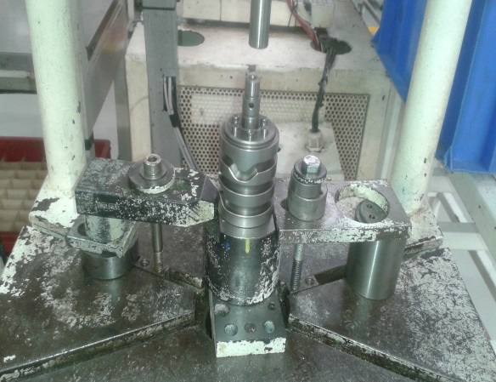
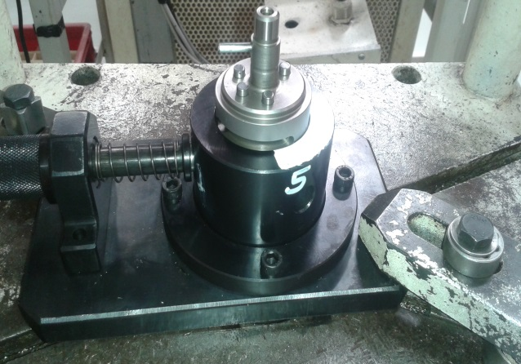
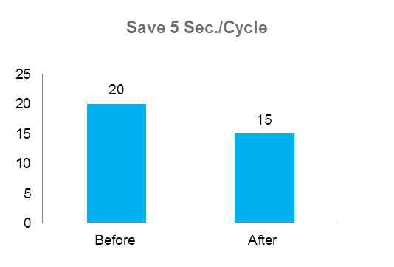
P15
TPM CIRCLE NO :-
ACTIVITY
KK
QM
PM
JH
SHE
OT
DM
E&T
KAIZEN IDEA SHEET
TPM CIRCLE NAME:
LOSS NO. / STEP
DEPT :-
RESULT AREA
P
Q
A
C
D
S
M
CELL:-
CELL NAME:- Bracket SPM
MACHINE / STAGE :- A215 Pin pressing
OPERATION :- Five Pin pressing
KAIZEN THEME : To pin pressing reduce cycle time .
IDEA : Provide the five pin hole alignment orientation into the fixture
Problem present status :- Manually alignment pin pressing head & pressing plunger
COUNTERMEASURE:- Provide dimple on component locater alien the hole & tool position
BENCHMARK
20 Sec.
TARGET
15 Sec.
KAIZEN START
04.04.2017
KAIZEN FINISH
25.04.2017
TEAM MEMBERS :
Nitin Sutar
Sagar namekar
BENEFITS :-
P:- Increase the productivity by 120/day
Q:- Reduced the wrong pin pressing
M:- Reduced the operator fatigue increase
the Operator moral
Before
After
WHY - WHY ANALYSIS -
Why1 :- Current Cycle time 20 Sec.
Why2:- Manually alien the pressing tool & pressing pin head position.
Why3 :- Five pin location alien by manually.
Why4:- No provision for pin hole & pressing tool alignment into fixture
RESULT :- Five pin pressing, save 1 sec/pin pressing total
Save the 5 sec./component
KAIZEN SUSTENANCE
WHAT TO DO:-.
HOW TO DO:-visual
FREQUENCY :- As per PM schedule
ROOT CAUSE : No provision for pin hole & pressing tool alignment into fixture
SCOPE & PLAN FOR HORIZONTAL DEPLOYMENT
Sr No | CELL | TDC | RESP. | STATUS
1 | NA | NA | NA | NA
REGISTRATION NO. & DATE : 4.04.2017
REGISTERED BY :-Sagar Namekar
MANAGER’S SIGN :- Ganesh Gaikwad

